Slide 1
Breast Cancer EDA

Slide 2
Agenda

Slide 3
Data
Chart, df.info()?

Slide 4
Analytical Questions
Does age at initial diagnosis affect survivability?
Does Tumor size at initial diagnosis affect survivability?
How long is a patient likely to survive given an initial diagnosis of a T4 T stage compared to other stages or grades?
Do early diagnoses (N1, IIA, Grade 1) play a part in survivability?

Slide 5
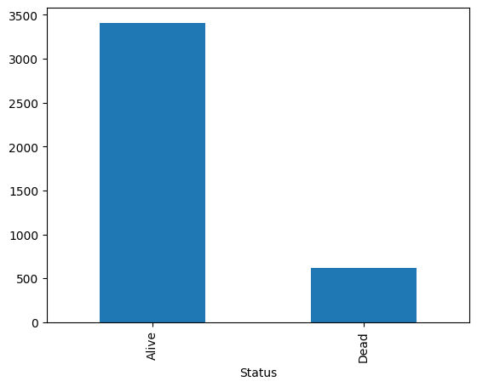
Data Distribution – Alive/Dead
COMBINED BAR CHART?

Slide 6
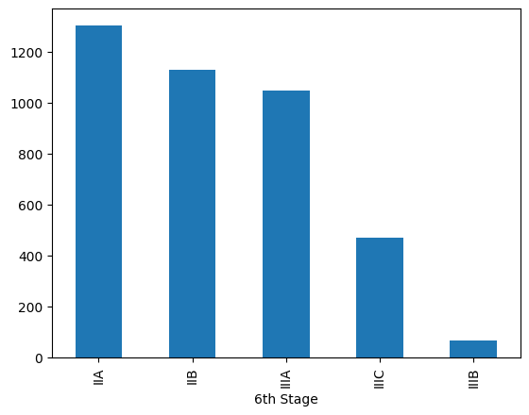
Data Distribution – 6th Stage

Slide 7
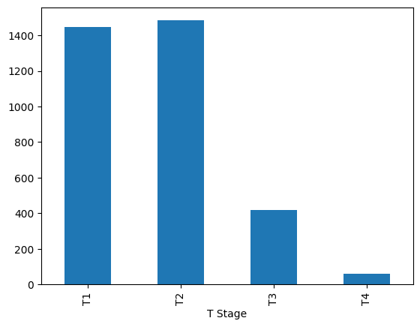
Data Distribution – T Stage

Slide 8
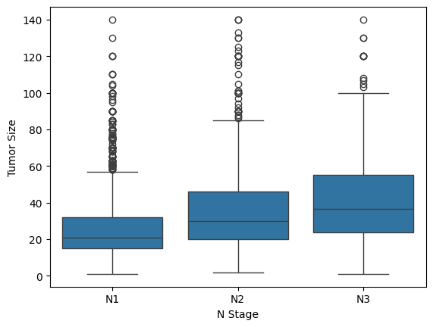
Bivariate Analysis – N Stage vs Tumor Size

Slide 9
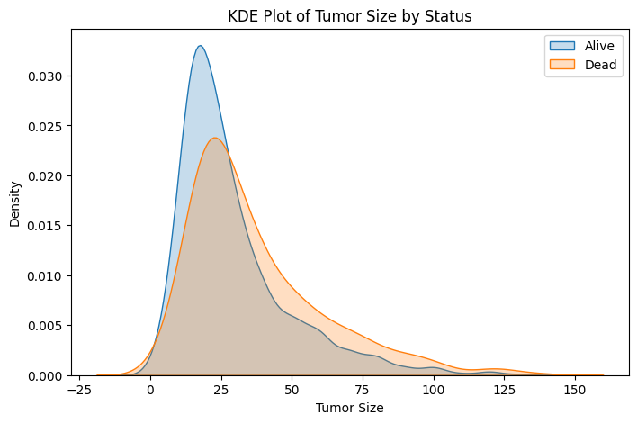
Bivariate Analysis – Tumor Size vs Status

Slide 10
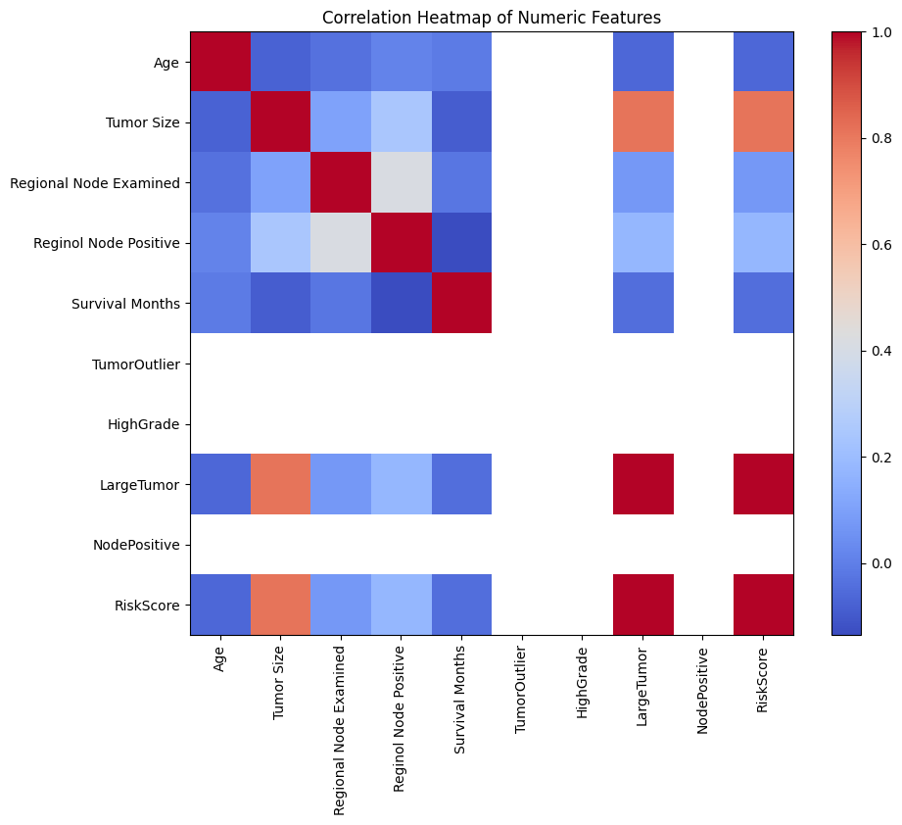
Correlation Heatmap
Not COMPLETE

Slide 11
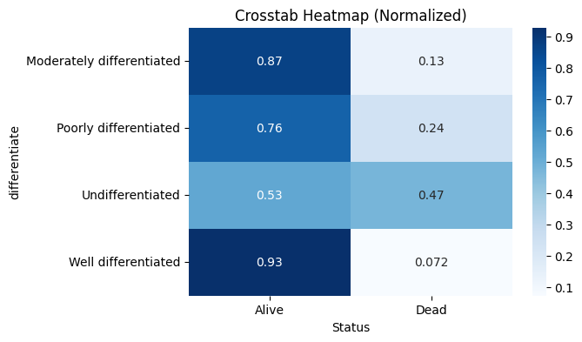
Does Cancer Cell differentiation identification contribute to survivability?

Slide 12
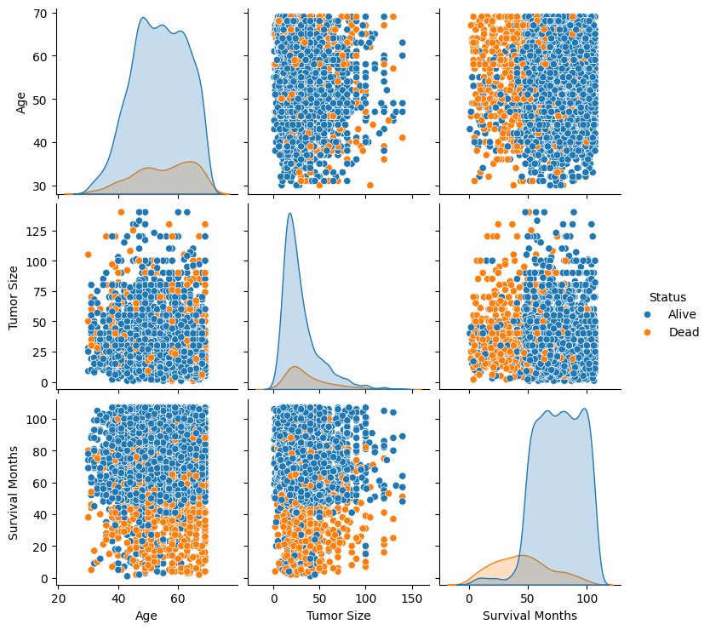
Pair plot

Slide 13
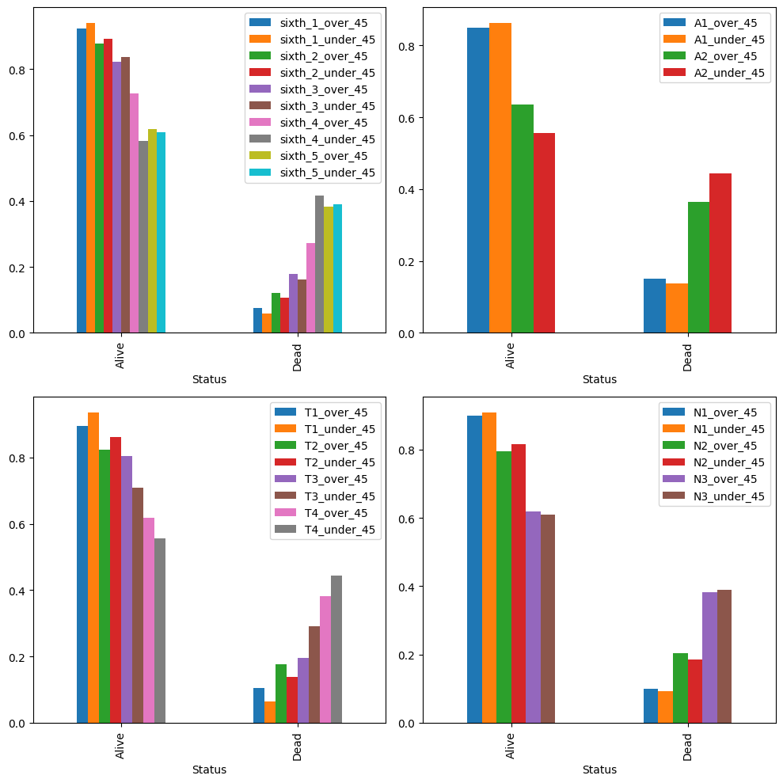
Age Analysis

Slide 14
Conclusions

